Slide 1
Generating Race, Sex, and Emotion detectors using Convolutional Neural Networks
By Komal Essarani

Slide 2
Agenda
Introduction
Datasets Used
Approach to develop model
Enhancing accuracy with SMOTE and AlexNet
Results
Next Steps

Slide 3
Introduction
Importance of face detection
Educational purposes
Biometric use
Educational purposes
Online lectures easier for professors
Can detect when student confused or paying attention
Biometric use
Eventual main source of identification

Slide 4
Datasets Used
Faces94
Uniform background
20 females, 133 males
FaceScrub
Noise in images
Background
Different angles
Multiple faces
10k US Adult Faces Database
Uniform background
2,222 of images include memorability scores
10,168 natural face photographs

Slide 5
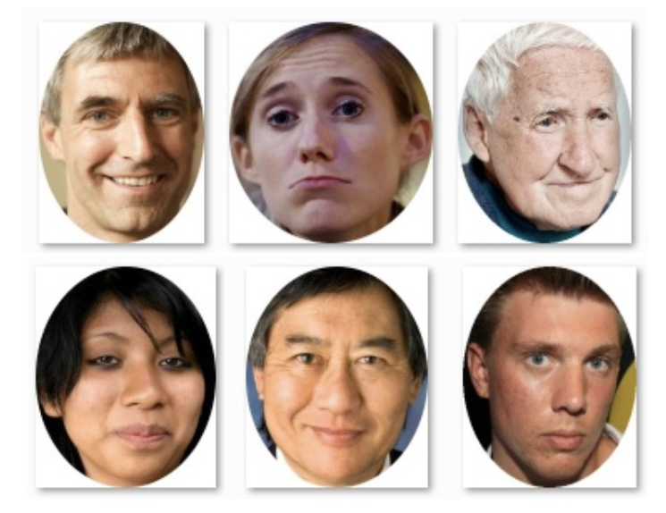
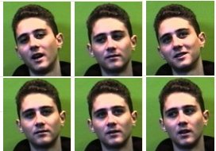
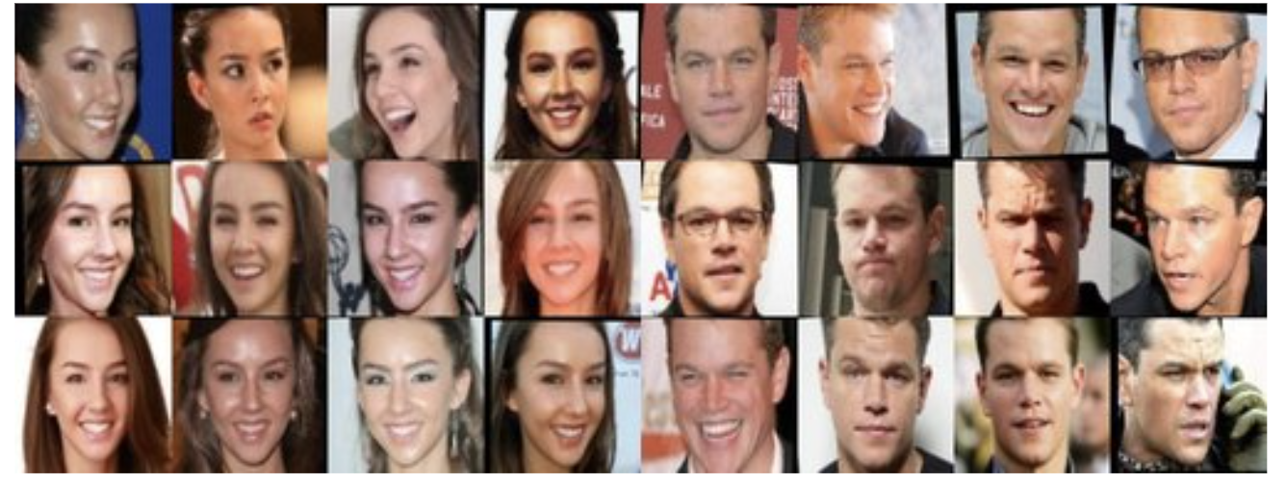
10k US Adult faces Database
Faces94
FaceScrub

Slide 6
Model Development
Formatted data into dictionary structure
Ex: [ {name: “astefa1.jpg”, img: [numpy array], gender: “female”} ]
Followed CNN tutorial
Split data into training and testing datasets
Added stacks of Conv2d and MaxPooling2D layers
Dense layers on top
Trained for 10 epochs

Slide 7
Enhancing code and results
Implemented train_test_split from scikit learn
Using stratify to split evenly
SMOTE to create synthetic data
Oversampling to make up for missing data
AlexNet architecture → more complex than original
Resize all images to 256x256

Slide 8
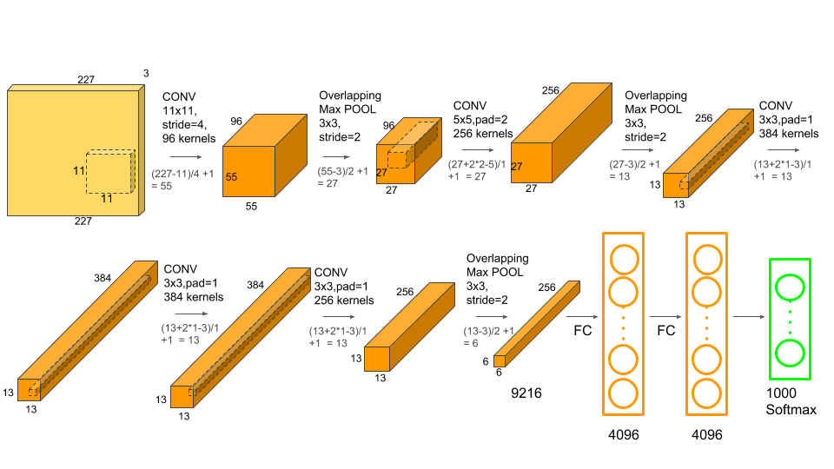

Slide 9
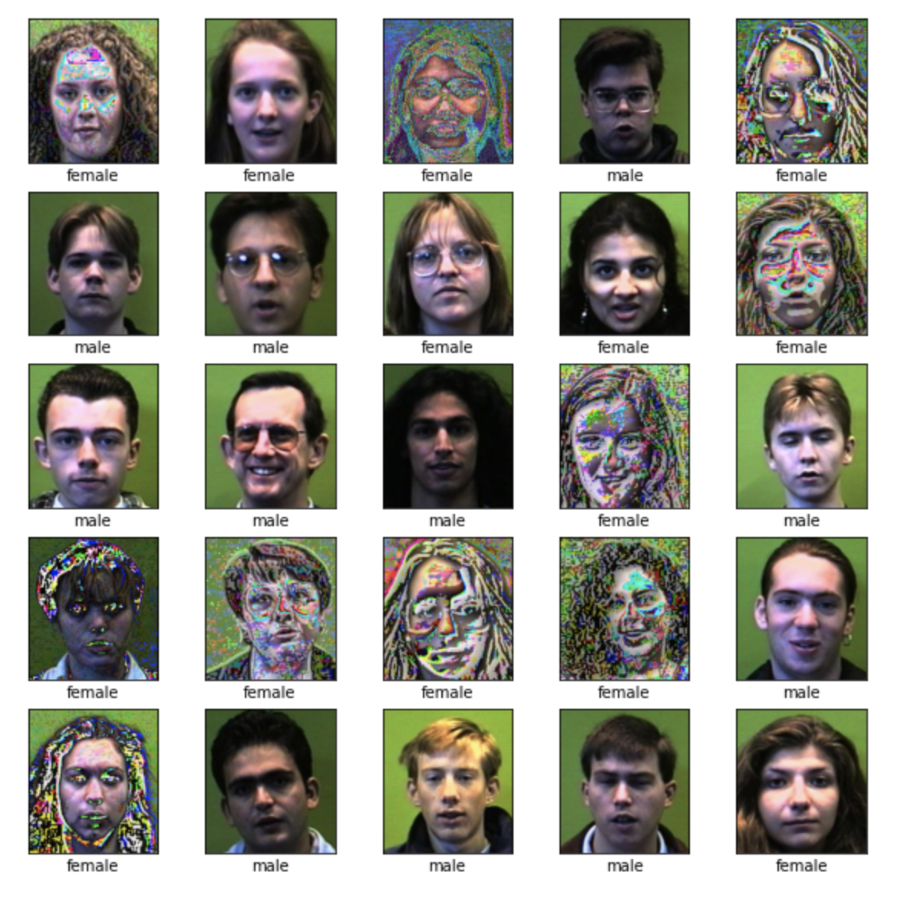
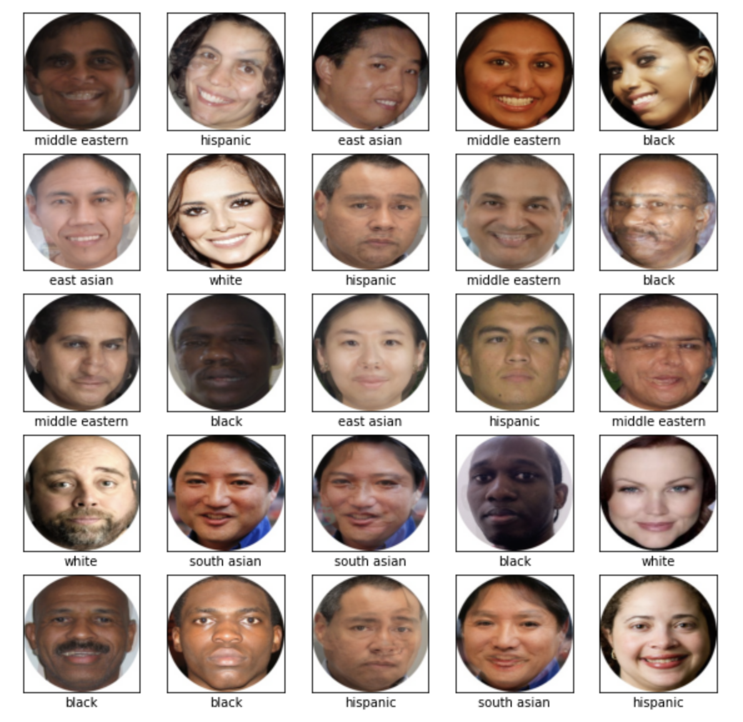

Slide 10
Faces94 Database Gender Detector
Accuracy: 0.9917
Ran several times to get accuracy high
Final dataset consisted of 2660 images - ½ female, ½ male

Slide 11
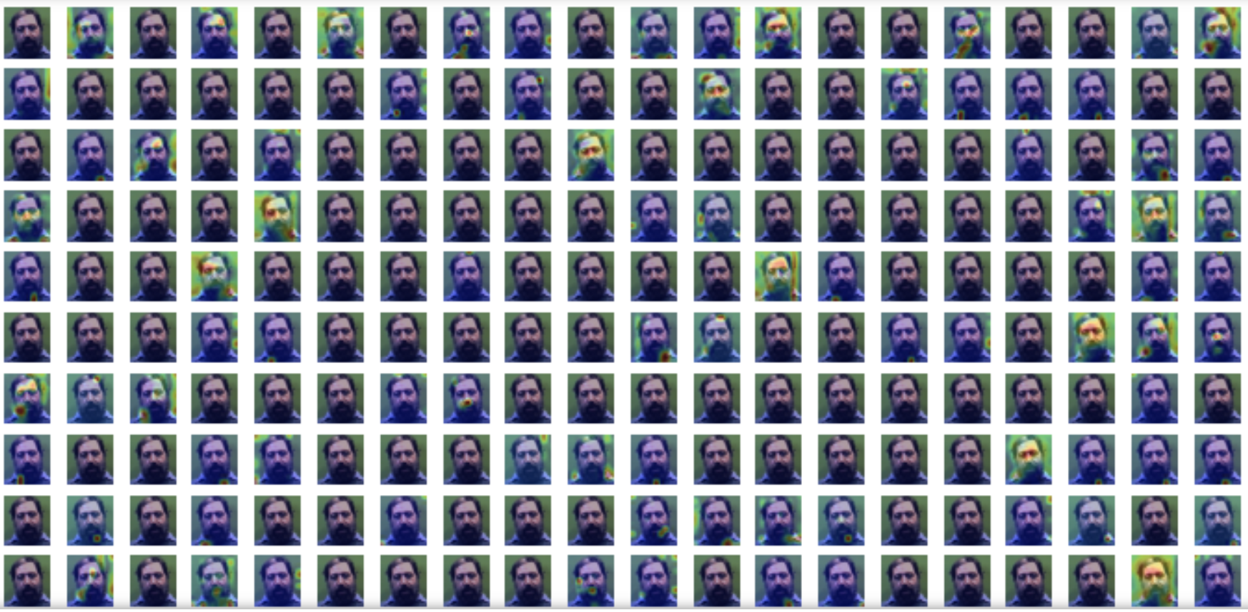

Slide 12
10k US Adult Faces Database Emotion Detector
Accuracy: 0.87315
Final dataset consists of 9066 images (including SMOTE)
happiness: 756
disgust: 756
anger: 756
neutral: 755
sadness: 755
surprise: 755

Slide 13
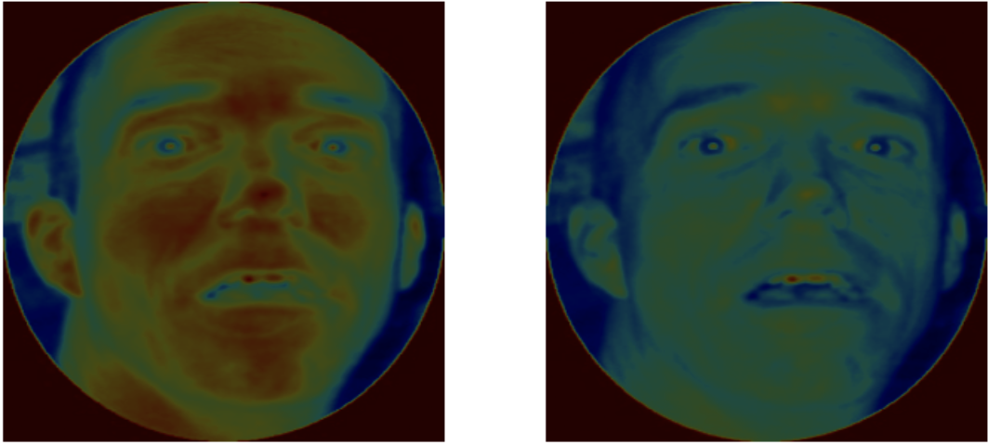

Slide 14
10k US Adult Faces Database Race Detector
Accuracy: 0.96109
Final dataset consists of 6426 images
918 of each race
Other
White
Black
East asian
South asian
Hispanic
Middle eastern

Slide 15
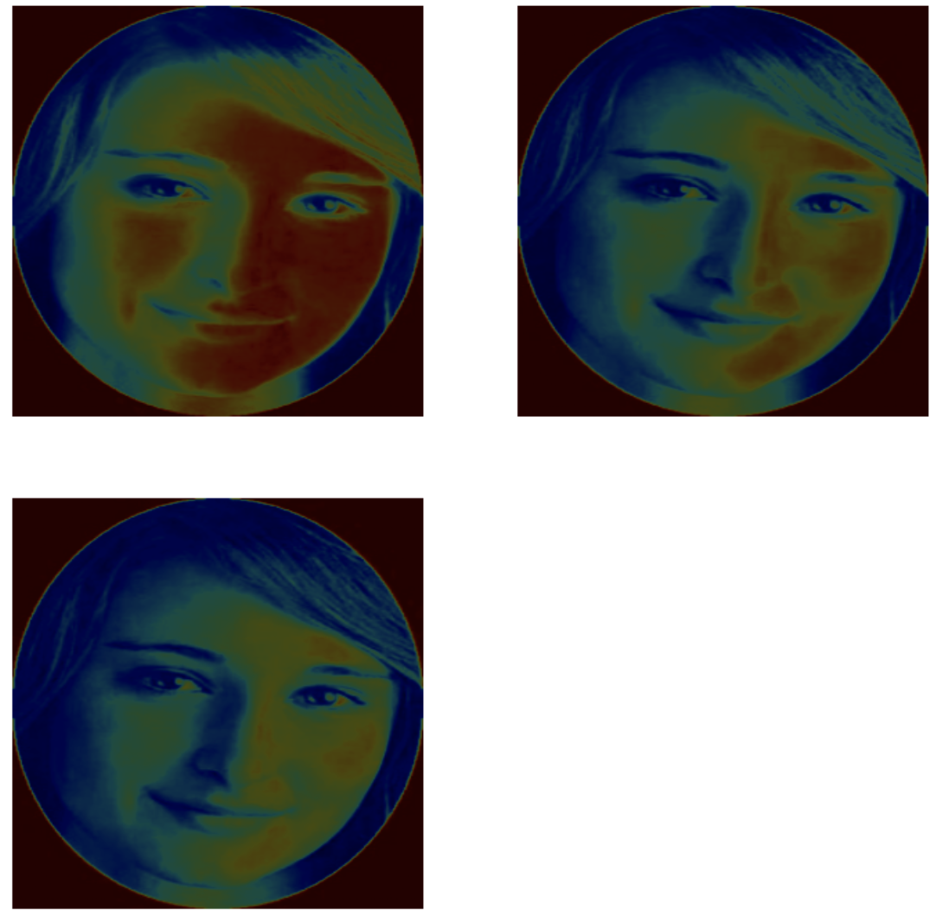

Slide 16
Cropping vs. Uncropped Images
Cropped out pictures reduce accuracy
Areas on face are cropped out
Hair, forehead, etc.
For each database and test
Uncropped images did significantly better

Slide 17
Next Steps
Minimize noise in images
Better detection of faces → cropped vs. uncropped
Live detection of faces
Combine all programs into one

